Slide 1

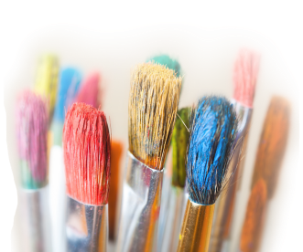
THE IMPACT OF THE SENSES
ON MEETINGS
Dianne Budion Devitt
www.diannedevitt.com

Slide 3
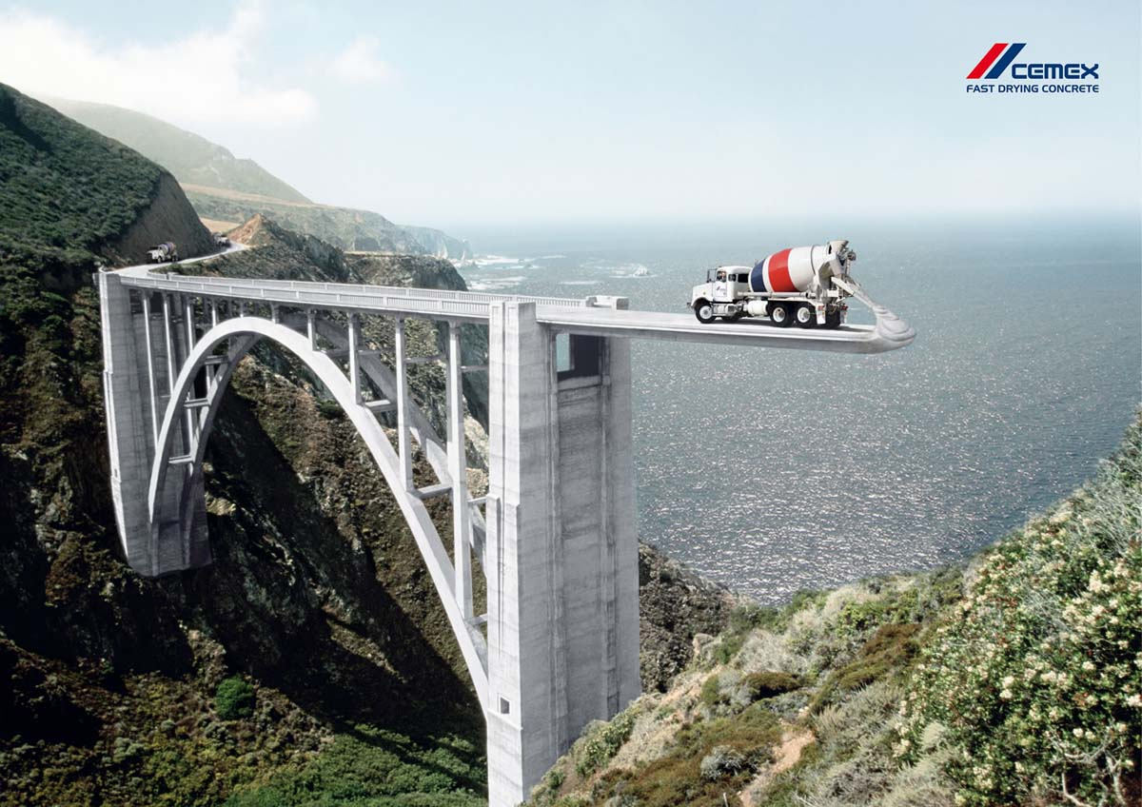

Slide 4
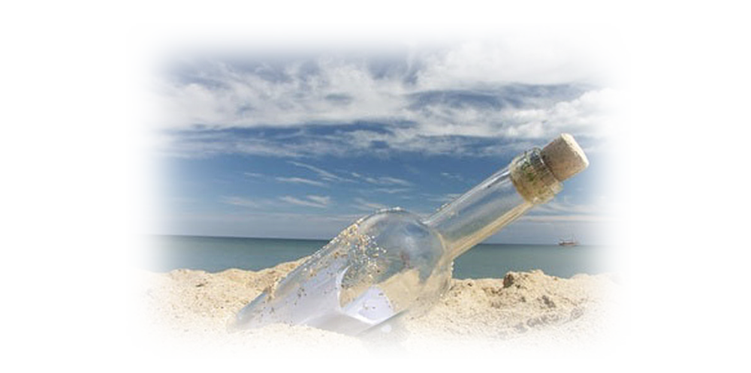
Un-Conscious Messaging
11,000,000

Slide 5
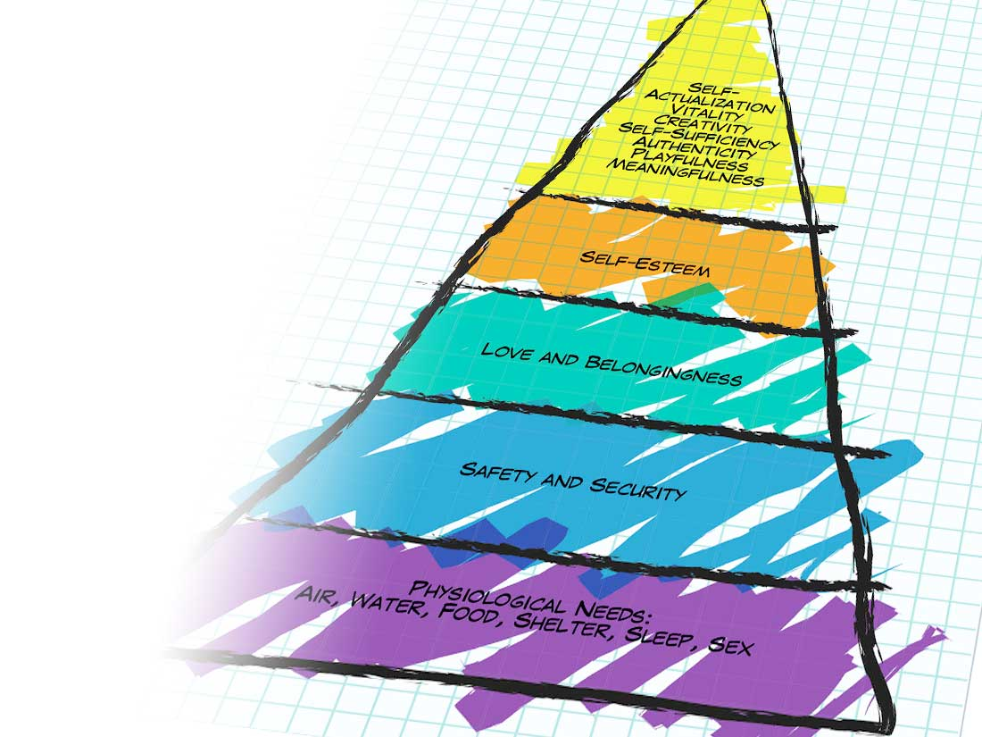

Slide 6

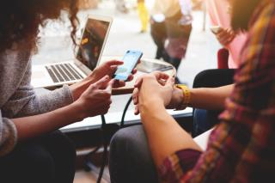
Did You Know…?
Modern robotic technology can detect human emotions with 83% accuracy.
85% of Communication is non-verbal
We remember 12-15% of what we hear
We retain over 80% of sensory experiences
.
Marketers reach their customers through the senses

Slide 7
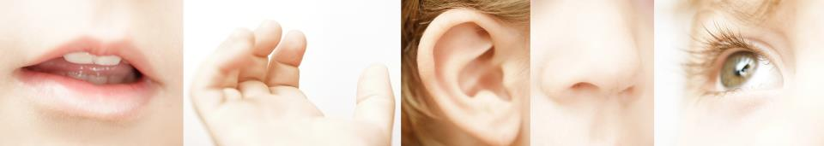
Who is Paying Attention to the Senses?
Advertising Executives
Architects
Communication Specialists
Display
Entertainment
Experiential Events
Finance
Fragrance and Flavor Houses
Healthcare
Hospitality
Human Resource
Interior Designers
Luxury Marketers
Marketing Agencies
Marketing solution providers
Medical
Packaging designers
Point of Sale providers
Public Relations
Real Estate Developers
Restaurants
Retail
Sports
Technology
Transportation

Slide 8
Half of 8 = 3
½ 8=3
x
It’s all in the Numbers

Slide 9
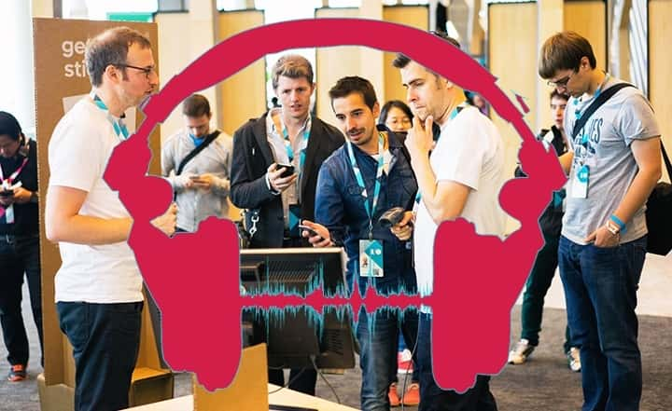
Research Results Revealed
Rank the Senses by Priority based on Meeting Type
(100 Senior Level Incentive & Meeting Planners Polled. Ranked 1-5 with 5 being highest).
 | Average of TOUCH | Average of SIGHT | Average of HEARING | Average of SMELL | Average of TASTE
Advisory Board | 1.73 | 4.27 | 4.75 | 2.30 | 2.00
Board of Directors | 2.45 | 4.27 | 4.58 | 1.60 | 2.20
Convention | 2.82 | 4.83 | 3.50 | 2.30 | 2.08
Corporate Anniversary | 2.90 | 3.80 | 2.00 | 2.60 | 3.82
Holiday Party | 2.36 | 3.09 | 2.45 | 3.50 | 4.42
Incentive | 3.82 | 4.00 | 1.82 | 2.64 | 3.64
Sales Training | 3.00 | 3.92 | 4.75 | 1.40 | 2.00
Shareholder Meeting | 2.30 | 4.45 | 4.42 | 1.89 | 1.90
Staff | 2.90 | 3.64 | 4.42 | 2.00 | 2.00
Team Building | 5.00 | 3.40 | 3.73 | 1.30 | 1.70
Town Hall | 2.90 | 3.90 | 5.00 | 1.60 | 1.60
Trade Show/Expo | 3.18 | 4.67 | 3.73 | 2.36 | 2.00
Union Meeting | 2.90 | 4.10 | 4.75 | 1.70 | 1.60
Grand Total | 2.96 | 4.04 | 3.89 | 2.12 | 2.42
* Research through Dianne Devitt – January 2017

Slide 10
The Top Two Senses According to the Generations
 |  | Generation
 |  | Millennials | Gen-Xers | Boomers | Seniors
 |  | % | % | % | %
 |  | 72 | 78 | 91 | 94
 |  | 56 | 70 | 70 | 69
 |  | 28 | 22 | 17 | 14
 |  | 27 | 17 | 13 | 15
 |  | 16 | 12 | 9 | 8
 | Average Adult
Ranked first or second | %
Sight | 82
Hearing | 66
Touch | 22
Taste | 19
Smell | 12
75% of Job Success is Related to Social and Emotional Intelligence. Only 25% is based on skill – Wrightliving.com

Slide 11
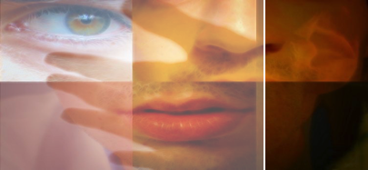
KeepUP!
“Recent Scientific developments in the understanding of how the brain processes multisensory stimulation have taken sensory marketing on a new level of sophistication.” – AdMap Article April 2015
Hospitality, real estate, entertainment, gaming, medical, financial
fields are expanding into the benefits of sensory marketing to engage the senses and improve guest experience.
Universities and researchers are growing in the field of sensory marketing.
A recent study conducted in the USA and the UK revealed that in today’s digital world, … more than 7 in 10 people crave experiences that stimulate their senses

Slide 12
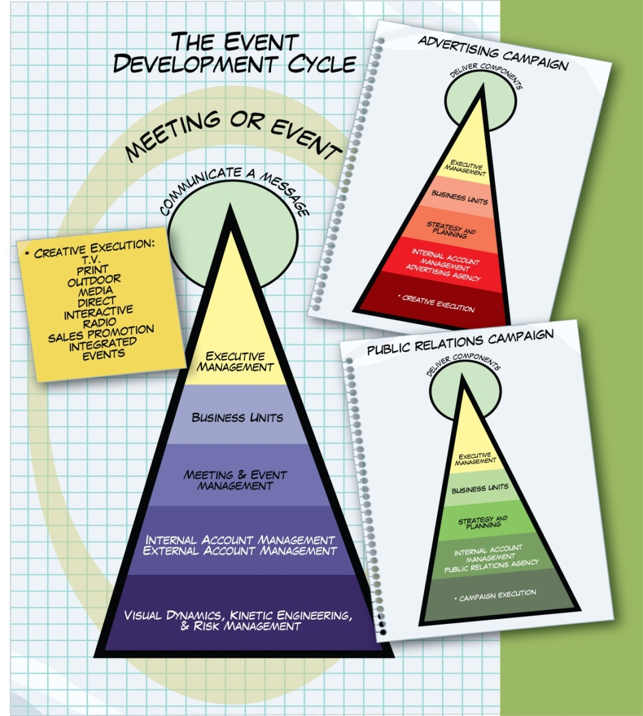

Slide 13
Communicate a Message:
ADVERTISING
(internal and external resources)
MEETINGS & EVENTS
(internal and external resources)
Executive
Management’s
OBJECTIVES
& GOALS
PUBLIC RELATIONS
(internal and external resources)

Slide 14
The Five E’s in Planning an Meeting Experience
SIX – EXPAND
Envision
PRE
Extend
Engage
POST
DURING
Exit
Experience
DURING
DURING

Slide 15
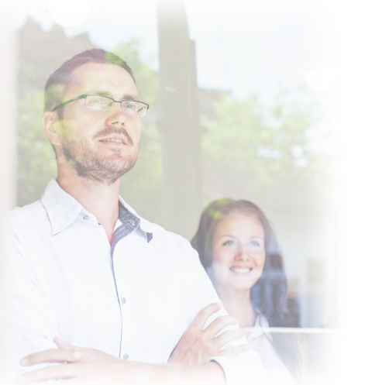
See Possibilities:
BLUE GREEN GOLD
red BLACK yellow
GREEN PINK ORANGE
PURPLE green BROWN
YELLOW BROWN blue
orange RED BLACK
PURPLE gold YELLOW

Slide 16
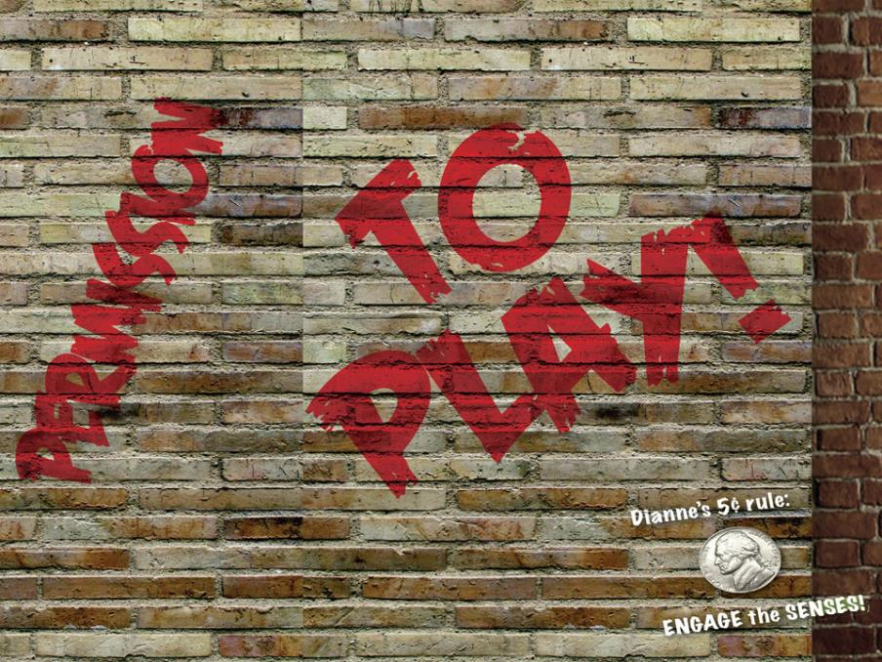

Slide 17
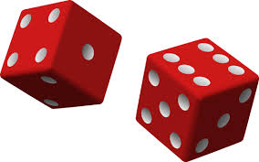
The Play’s the Thing
Seven to Ten Touch Points
Role of Touch Points
Impact to Incentive experience

Slide 18
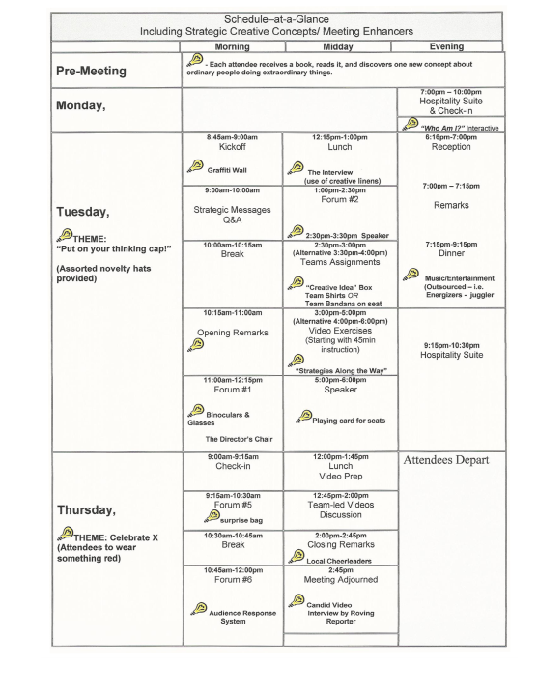

Notes:
Emotional pulse points- event enhancers

Slide 19

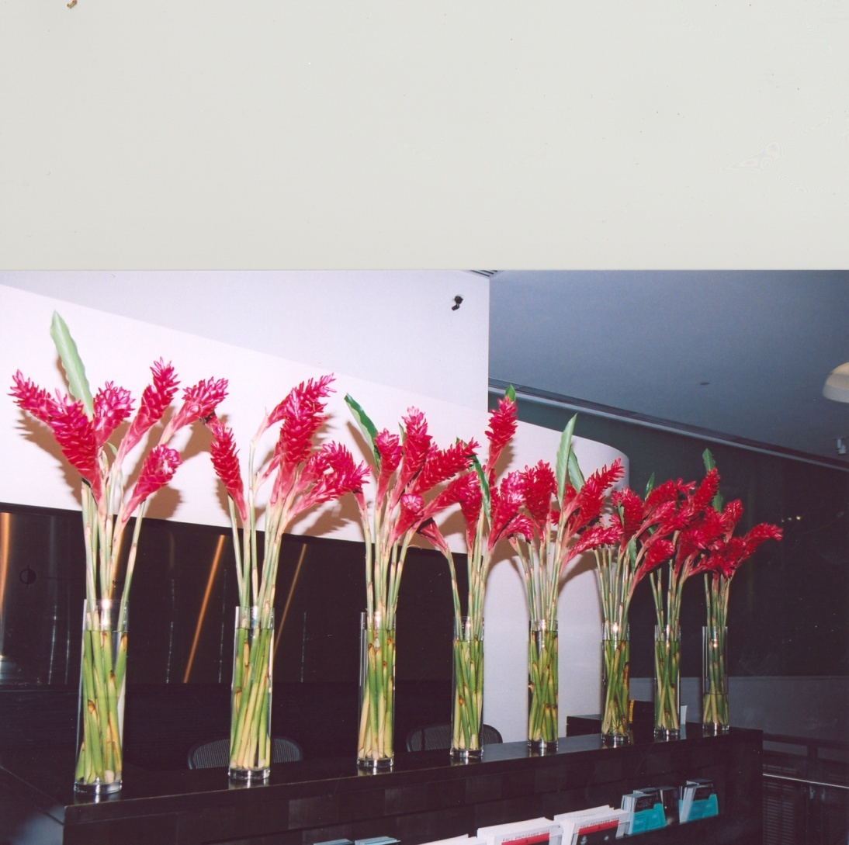
Sight
X 20,000

Slide 20

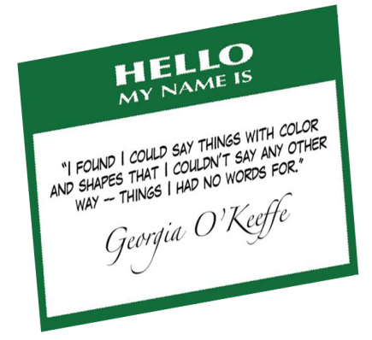
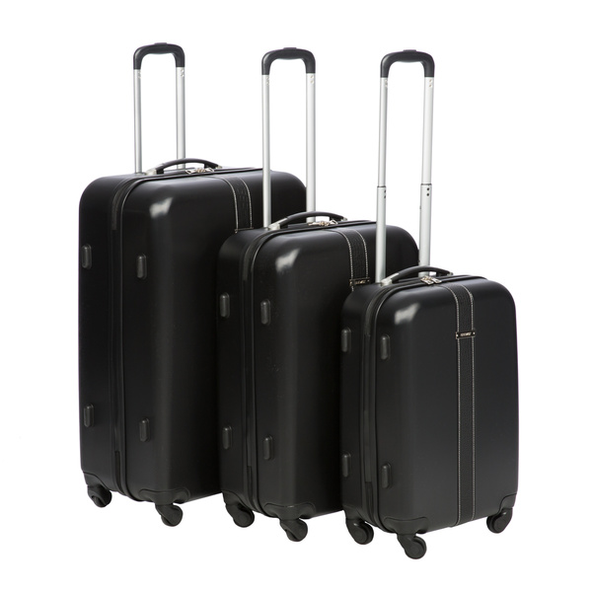
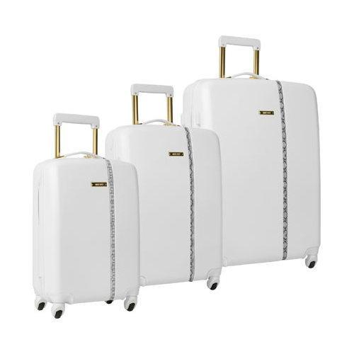

Slide 21
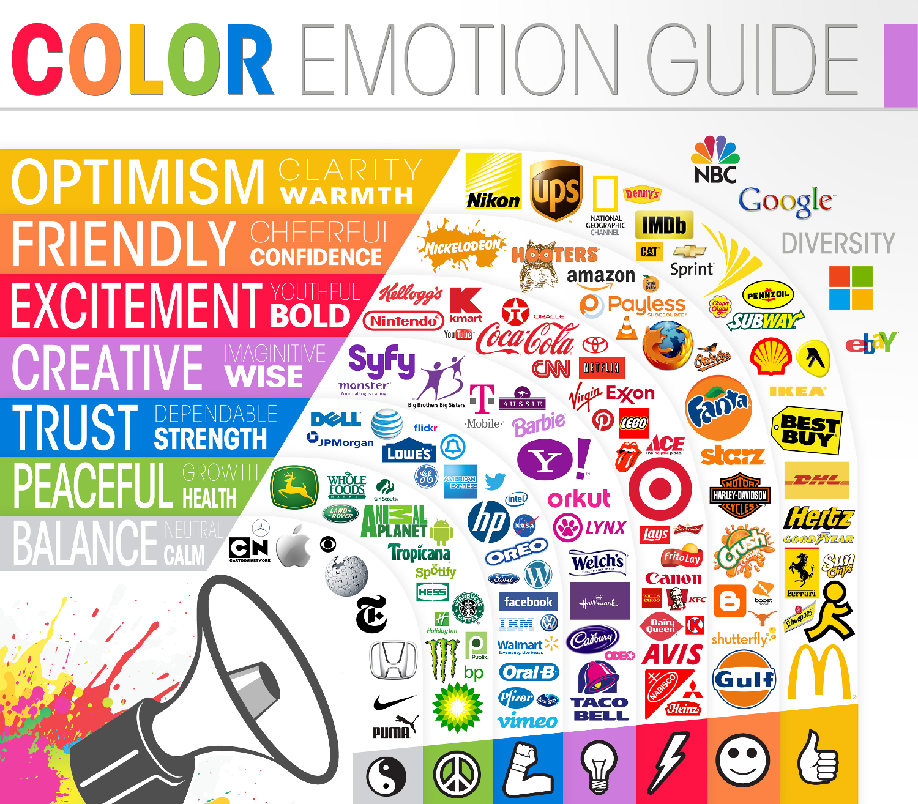
Color Emotion Guide
“Psychology of Color in Logo Design” – Simon McArdle
85% of shoppers place color as a primary reason why they buy a particular product; color increases brand recognition by 80%.

Slide 22
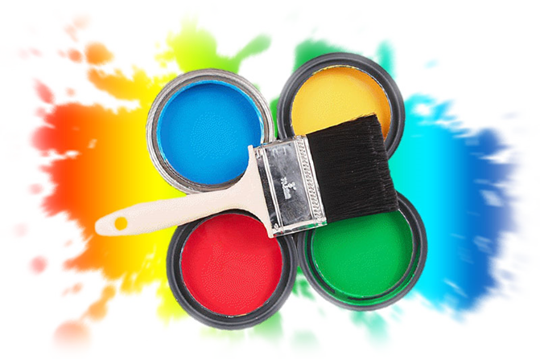
How to Tell the Story ?
Creative choices …To make Sense

Slide 23
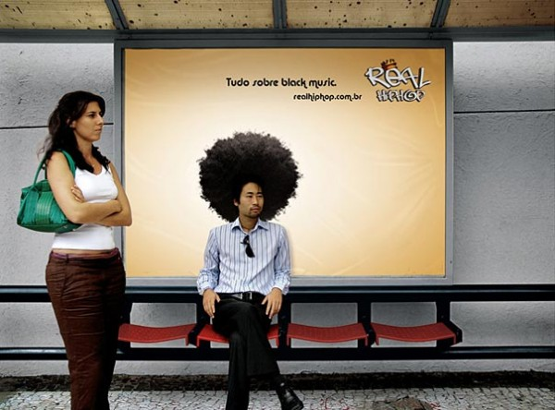
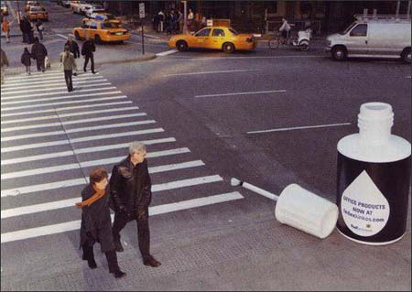
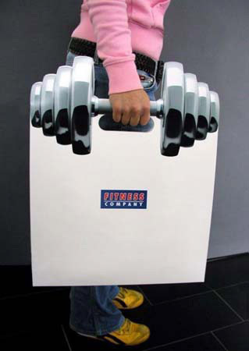
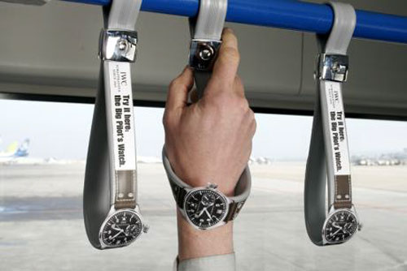
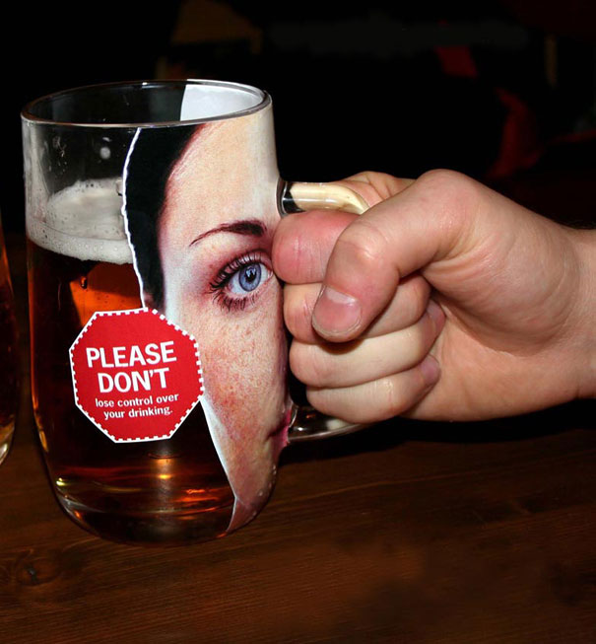

Slide 24

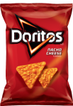

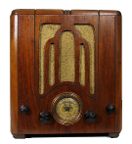

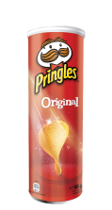

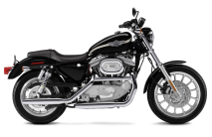
Hearing
-$3Billion is lost every year in productivity due to poor listening skills
-Brands with music that fit their brand identity are 96% more likely to be remembered

Slide 25
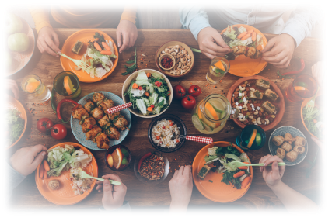
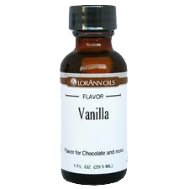
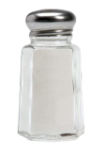
Taste
“There is no sincerer love than the love of food.”
– George Bernard Shaw

Slide 26
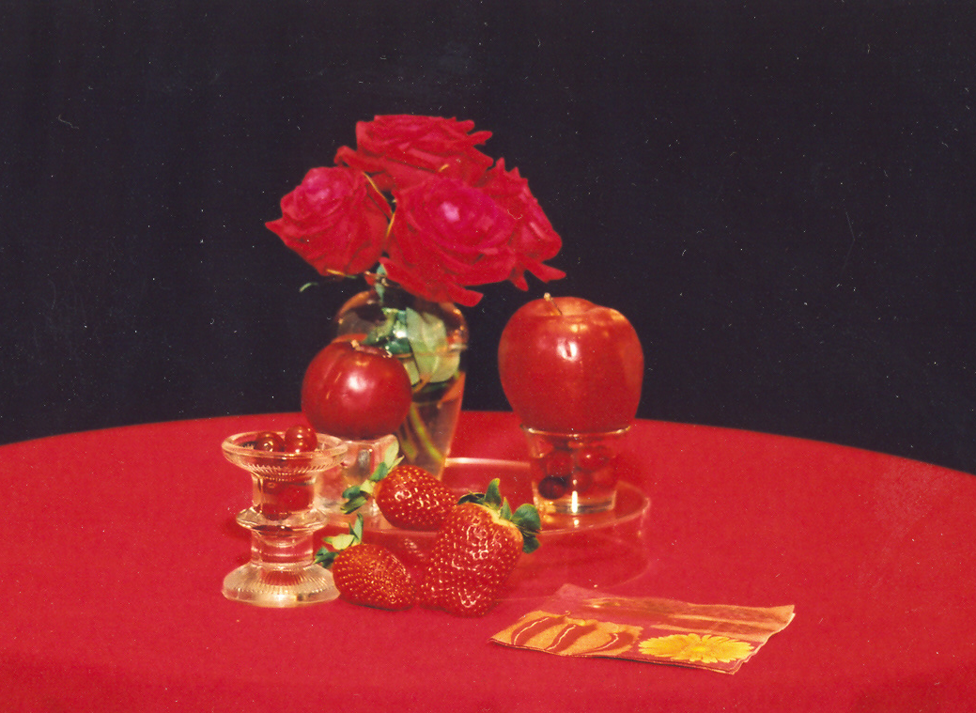

Slide 27
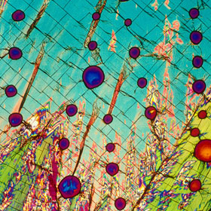
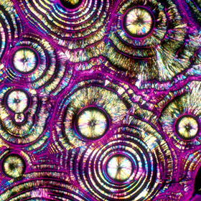
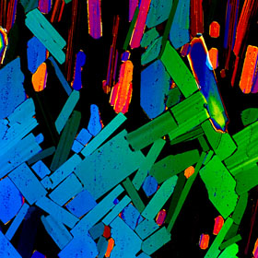
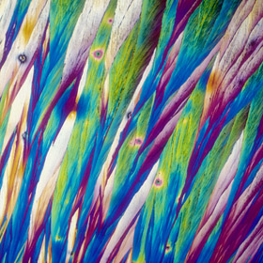
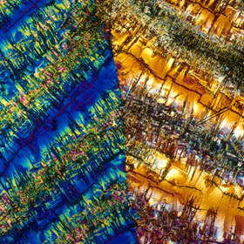
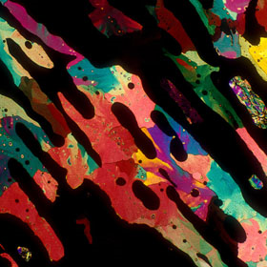
What Am I?

Slide 28
!
VODKA | VODKA TONIC | TEQUILA
MARGUERITA | AUSTRALIAN PALE LAGER | COSMO MARTINI
“BevShots” by Michael Davidson Photomicrography

Slide 29



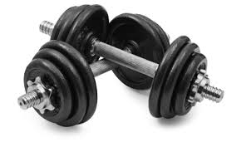
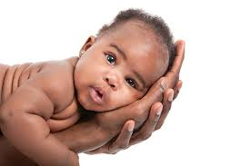
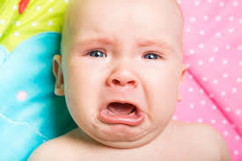
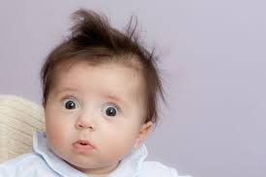
Touch

Slide 30
Touch Me… Hug Me
4,000,000 Sensory Receptors are Waiting

Slide 31
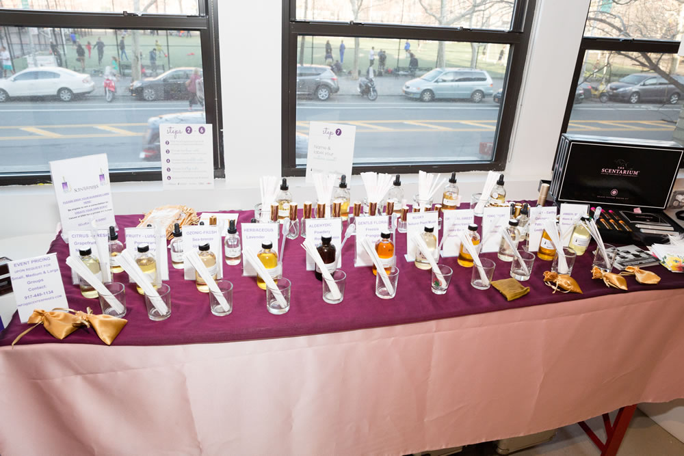
Scent
Only 3% of Fortune 1000 companies have given thought to using smell in their marketing or branding, despite the claim that 75% of our emotions are generated by what we smell.
“A rose is a rose is a rose – unless it’s a tomato or a phone or 10,000 other choices”
– Alice B. Toklas & Dianne B. Devitt

Slide 32
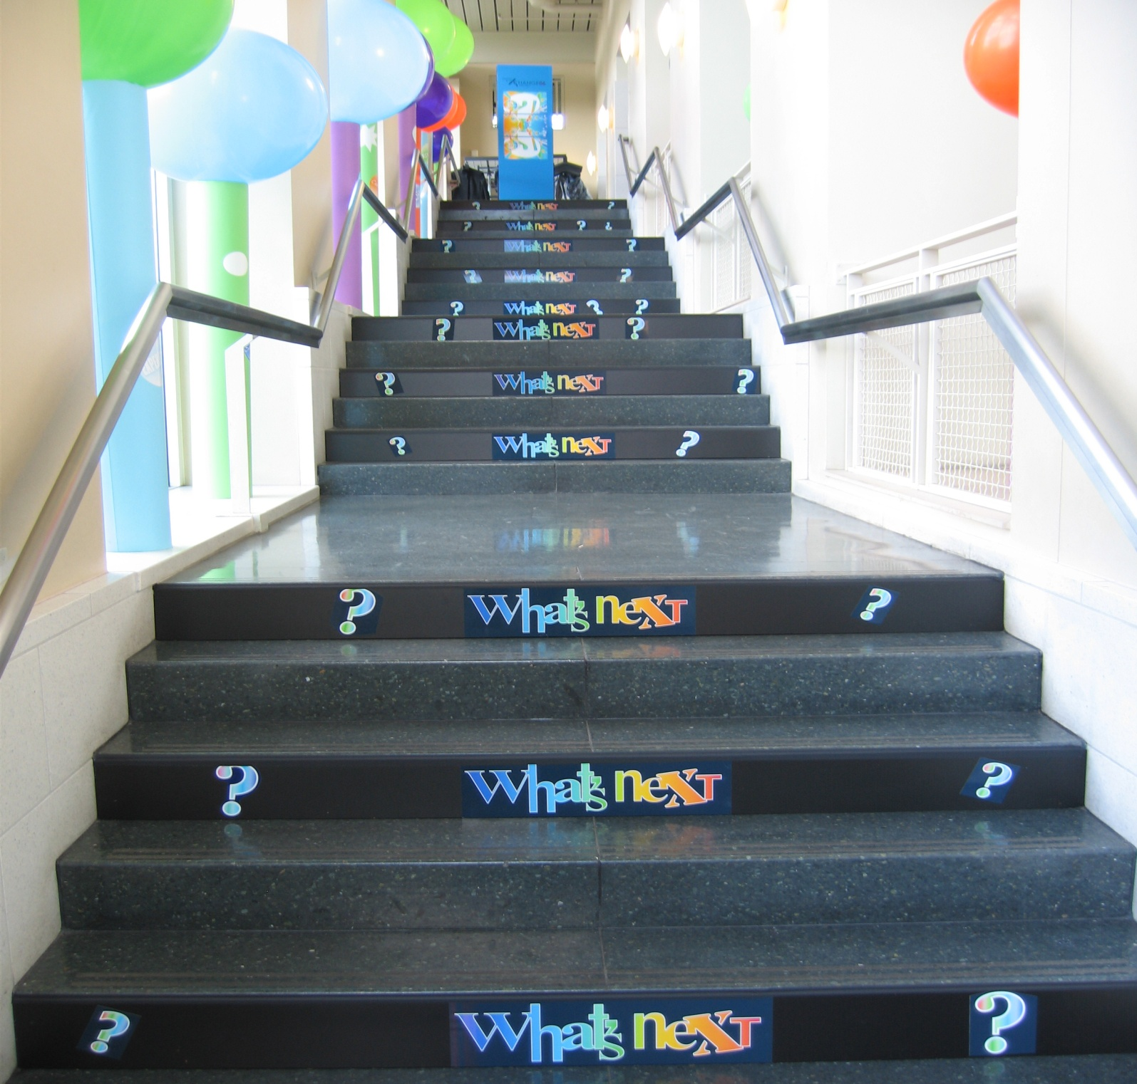

Slide 33
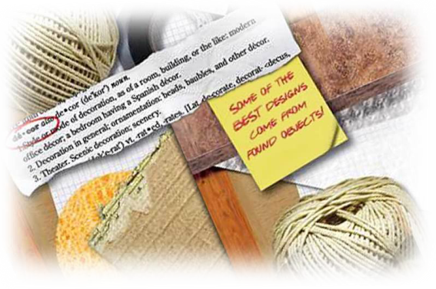
Finding Inspiration

Slide 34

Time to Create A Story

Slide 35


“People will forget what you said.
People will forget what you did.
But people will never forget
how you made them feel.”
– Maya Angelou

Slide 36
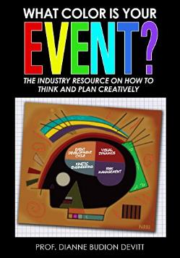
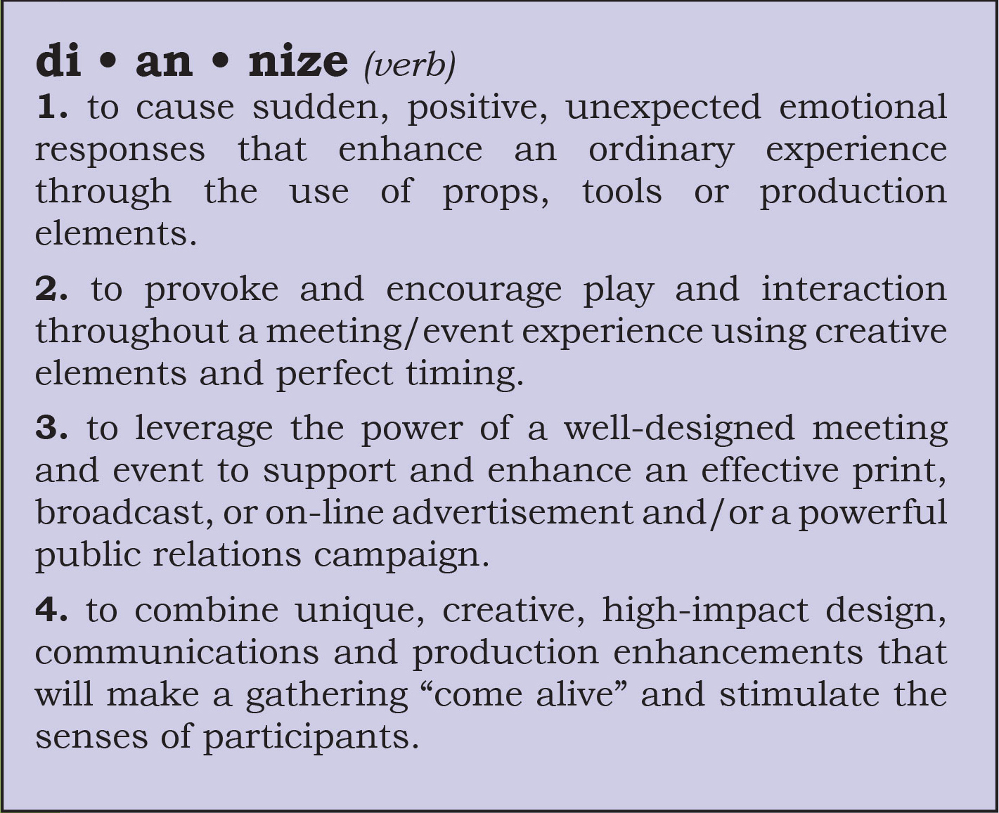
Reference Book
https://www.amazon.com/What-Color-Your-Event-Creatively-ebook/dp/B07BFQVLXL

Slide 37
Thank You!
We’ll see you at another Visionary Summit soon!

